Slide 1
Instrumental Variables Estimation and
Two Stage Least Squares

Slide 2
Instrumental Variables Estimation and Two Stage Least Squares
The endogeneity problem is endemic in social sciences/economics
  In many cases important personal variables cannot be observed
  These are often correlated with observed explanatory information
  In addition, measurement error may also lead to endogeneity
  Solutions to endogeneity problems considered so far:
    Proxy variables method for omitted regressors
    Fixed effects methods if 1) panel data is available, 2) endogeneity is time-constant, and 3) regressors are not time-constant
Instrumental variables method (IV)
  IV is the most well-known method to address endogeneity problems

Slide 3


Instrumental Variables Estimation and Two Stage Least Squares
Motivation: Omitted Variables in a Simple Regression Model
Example: Education in a wage equation
Definition of a instrumental variable:
  1) It does not appear in the regression
  2) It is highly correlated with the endogenous variable
  3) It is uncorrelated with the error term
Reconsideration of OLS in a simple regression model
Error terms contains factors such as innate ability which are correlated with education
and assume

Slide 4
Instrumental Variables Estimation and Two Stage Least Squares
An simple consistency proof for OLS under exogeneity:
(Exogeneity)
This holds as long as the data are such that sample variances and cova-riances converge to their theoretical counterparts as n → 1, i.e. if a LLN holds. OLS will basically be consistent if, and only if, exogeneity holds.

Slide 5


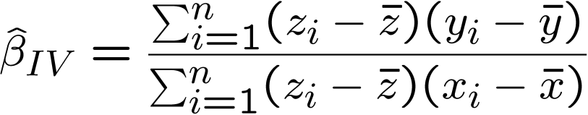
Instrumental Variables Estimation and Two Stage Least Squares
Assume existence of an instrumental variable :
(but )
The instrumental variable is un-correlated with the error term
IV-estimator:
The instrumental variable is correlated with the explanatory variable

Slide 6
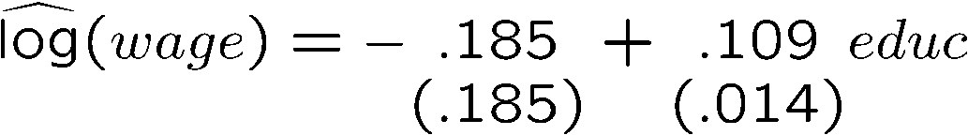



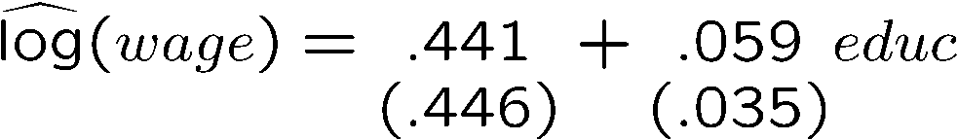
Instrumental Variables Estimation and Two Stage Least Squares
Example: Father‘s education as an IV for education
OLS:
Return to education probably overestimated
Is the education of the father a good IV?
It doesn‘t appear as regressor
It is significantly correlated with educ
It is uncorrelated with the error (?)
The estimated return to education decreases (which is to be expected)
It is also much less precisely estimated
IV:

Slide 7
Instrumental Variables Estimation and Two Stage Least Squares
Other IVs for education that have been used in the literature:
The number of siblings
  1) No wage determinant, 2) Correlated with education because of resource constraints in hh, 3) Uncorrelated with innate ability
College proximity when 16 years old
  1) No wage determinant, 2) Correlated with education because more education if lived near college, 3) Uncorrelated with error (?)
Month of birth
  1) No wage determinant, 2) Correlated with education because of compulsory school attendance laws, 3) Uncorrelated with error

Slide 8
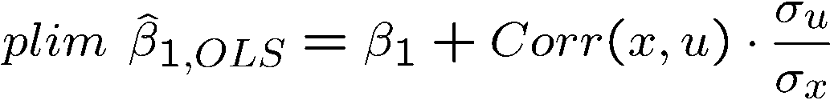
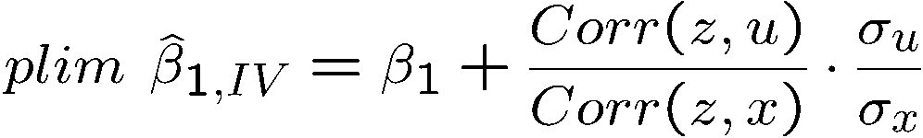
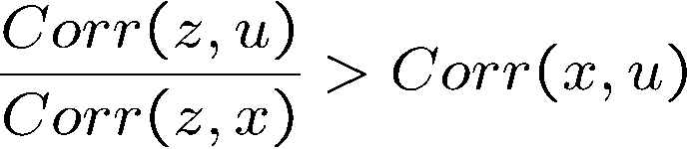
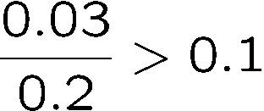
Instrumental Variables Estimation and Two Stage Least Squares
Properties of IV with a poor instrumental variable
  IV may be much more inconsistent than OLS if the instrumental variable is not completely exogenous and only weakly related to
There is no problem if the instrumental variable is really exogenous. If not, the asymp-totic bias will be the larger the weaker the correlation with x.
IV worse than OLS if:
e.g.

Slide 9

Instrumental Variables Estimation and Two Stage Least Squares
IV estimation in the multiple regression model
Conditions for instrumental variable
  1) Does not appear in regression equation
  2) Is uncorrelated with error term
  3) Is partially correlated with endogenous explanatory variable
endogenous
exogenous variables
In a regression of the endogenous explanatory variable on all exogenous variables, the instrumental variable must have a non-zero coefficient.
This is the so called “reduced form regression”

Slide 10


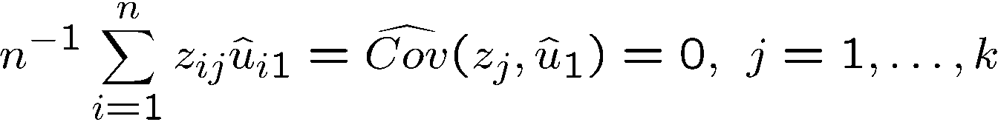

Instrumental Variables Estimation and Two Stage Least Squares
Computing IV estimates in the multiple regression case:
Exogeneity conditions:
as well as
Use sample analogs of the exogeneity conditions:
This yields k+1 equations from which the k+1 estimates can be obtained.

Slide 11
Instrumental Variables Estimation and Two Stage Least Squares
Two Stage Least Squares (2SLS) estimation
  It turns out that the IV estimator is equivalent to the following procedure, which has a much more intuitive interpretation:
First stage (= reduced form regression):
The endogenous explanatory variable y₂ is predicted using only exogenous information
Additional exogenous variable (= instrument)
Second stage (= OLS with y₂ replaced by its prediction from the first stage):

Slide 12
Instrumental Variables Estimation and Two Stage Least Squares
Why does Two Stage Least Squares work?
  All variables in the second stage regression are exogenous because y₂ was replaced by a prediction based on only exogenous information
  By using the prediction based on exogenous information, y₂ is purged of its endogenous part (the part that is related to the error term)

Slide 13
Instrumental Variables Estimation and Two Stage Least Squares
Properties of Two Stage Least Squares
  The standard errors from the OLS second stage regression are wrong. However, it is not difficult to compute correct standard errors.
  If there is one endogenous variable and one instrument then 2SLS = IV
  The 2SLS estimation can also be used if there is more than one endo-genous variable and at least as many instruments

Slide 14
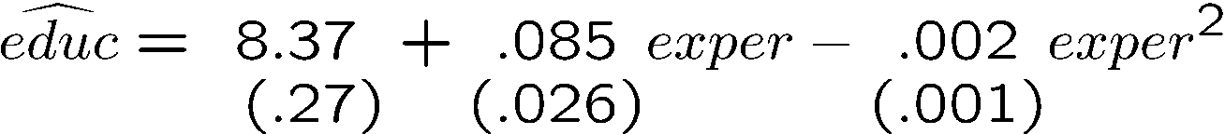
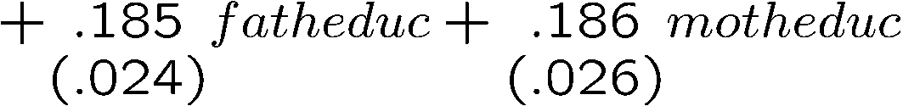


Instrumental Variables Estimation and Two Stage Least Squares
Example: 2SLS in a wage equation using two instruments
First stage regression (regress educ on all exogenous variables):
Education is significantly partially correlated with the education of the parents
Two Stage Least Squares estimation results:
The return to education is much lower but also much more imprecise than with OLS

Slide 15


Instrumental Variables Estimation and Two Stage Least Squares
Using 2SLS/IV as a solution to errors-in-variables problems
  If a second measurement of the mismeasured variable is available, this can be used as an instrumental variable for the mismeasured variable
Statistical properties of 2SLS/IV-estimation
  Under assumptions completely analogous to OLS, but conditioning on rather than on , 2SLS/IV is consistent and asymptotically normal

Slide 16
Instrumental Variables Estimation and Two Stage Least Squares
  2SLS/IV is typically much less precise because there is more multicollinearity and less explanatory variation in the second stage regression
  Corrections for heteroskedasticity/serial correlation analogous to OLS
  2SLS/IV easily extends to time series and panel data situations

Slide 17


Instrumental Variables Estimation and Two Stage Least Squares
Testing for endogeneity of explanatory variables
Variable that is suspected to be endogenous
Reduced form regression:
Variable y₂ is exogenous if and only if v₂ is uncorrelated with u₁, i.e. if the parameter is zero in the regression:
The null hypothesis of exogeneity of y₂ is rejected, if in this regression the parameter is significantly different from zero
Test equation:

